Slide 1
IBM MAINFRAMES
CICS Training Class-01

Slide 2
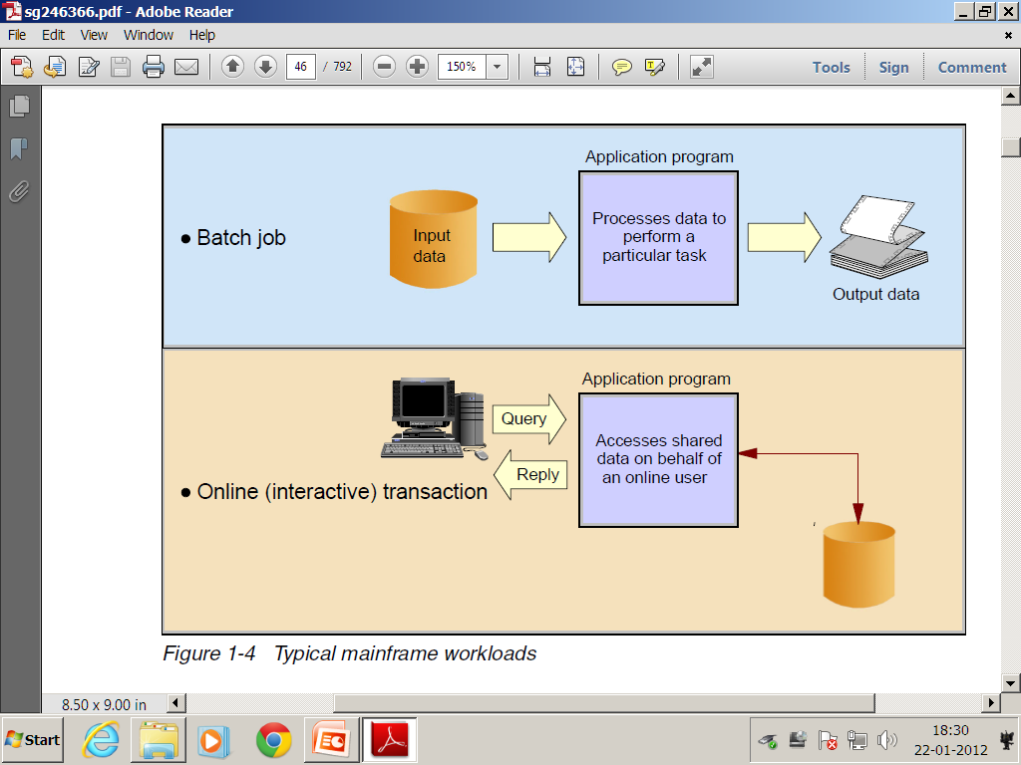
Typical mainframe workloads
Most mainframe workloads fall into one of two categories: batch processing or online transaction processing.

Slide 3
Batch processing
One key advantage of mainframe systems is their ability to process terabytes of data from high-speed storage devices and produce valuable output.
The applications that produce these statements are batch applications, that is, they are processed on the mainframe without user interaction.
A batch job is submitted (through JCL) on the computer, reads and processes data in bulk (perhaps terabytes of data), and produces output, such as customer billing statements.

Slide 4
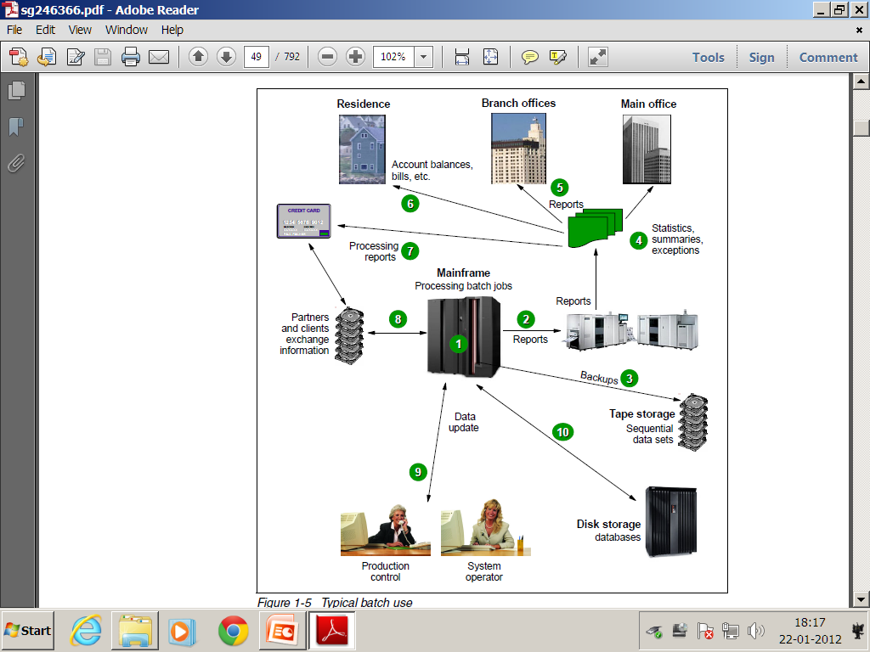


Slide 5
Online Transaction Processing
Transaction processing that occurs interactively with the user is referred to as online transaction processing (OLTP).
Transaction systems must be able to support an unpredictable number of concurrent users and transaction types. Most transactions are executed in short time periods.
These systems are currently supporting mission-critical applications; therefore, continuous availability, high performance, and data protection and integrity are required.

Slide 6
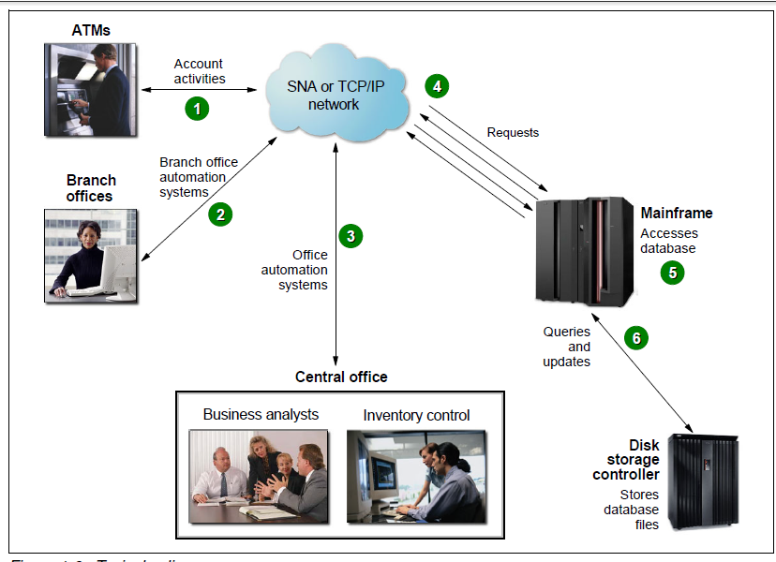


Slide 7
Difference Between Batch And Online
Batch System
Online System
Input data prepared before the execution
Processing sequence is predictable
Programs and files can't be shared
Programs are scheduled through JOBS
Recovery and restart is easy
Data is prepared at the time of execution as needed
Processing sequence is unpredictable
Programs and files can be shared
Programs are initiated through transactions any time
Recovery and restart requires additional process

Slide 8
Introduction To CICS
CICS stands for customer information and control system
Developed in late 1960’s as DB/DC control system
CICS provides an interface between the operating system and application program.
CICS can be used two different levels
  Macro level CICS initial version operated by assembler macros to request CICS services
  Command level CICS high level language version operated under command which can replace series of macros

Slide 9




CICS & Operating System
Operating System
CICS
DATABASE
Application Program
Terminal
DATASETS

Slide 10
CICS Components
Control Programs: these are the program that actually provide the interface between the operating system and application program to handle general functions of CICS
Control Tables: this defines the CICS environment. Functionally associated with control programs.
  To execute any program (TASK) in CICS we need to specify/define the program name in this table which further used by control program to execute (INITIATE).
Control Areas contains the system type information about the task and transaction

Slide 11

Control Tables And Control Programs
Control Table |  | Control Program
Processing Program Table | PPT PCP | Program Control Program
Program Control Table | PCT KCP | Task Control Program
File Control Table | FCT FCP | File Control Program
Terminal Control Table | TCT TCP | Terminal Control Program
Temporary Storage Table | TST TSP | Temporary Storage Program
N/A | SCP | Storage Control Program
N/A | ICP | Interval Control Program

Slide 12
BASIC MAPING SUPPORT

Slide 13
Introduction To BMS
The primary function of BMS is
  To design a screen with BMS macros
  To remove device and format dependency
  To provides Text handling
  To terminal Paging and Message Routing

Slide 14
Map And Mapset
Any screen developed with help of BMS macros is known as MAP and collection of one or more maps is known as MAPSET
Multimap Panel : Single panel with two or more maps in it at once.
Multiple Map: Single screen with two or more maps in it but one at a time
To design a MAPSET:
  We can use either assembler language i.e., BMS MACROS or SDF (SCREEN DEFINITION FACILITY) Tool

Slide 15
Map Fields
Fields are of two types :
    Label Field
    Data Value Field
Label fields used to specify the label tags on the screen to specify information
Data value fields which can be used to pass the data between map and program
  Label fields does not contain names in name field where as data value filed does, which are used to create symbolic map data items.

Slide 16
BMS Macros
DFHMSD: DATA Facility Hierarchy Mapset Definition used to define a mapset and its characteristics and to specify end of the mapset
  Only one mapset is allowed in one assembly program
DFHMDI Map definition interface used to define a map and its characteristics. More than one map can be defined in a mapset program
DFHMDF map definition field used to define a field and its characteristics. More than one filed can be defined with-in a map

Slide 17
BMS Mapset Code Sheet
1 8 9 14 15 16 72
1-7 mapset /map/field name
8 Blank
9 – 14 BMS macros
15 blank
16-71 Parameter filed
72 continuation purpose denoted by symbol ‘X’.

Slide 18
STRUCTURE Of BMS Mapset Program
Name Field
Macro Field
Parameter Field
MAPSETNAME DFHMSD TYPE=&SYSPARM →DEFINE A MAPSET
  MAPNAME1 DFHMDI SIZE=(24,80) →DEFINE A MAP
    FILEDNAME DFHMDF POS=(10,30) → FILED
    FILEDNAME DFHMDF POS=(15,40) → FILED
    .
    .
  MAPNAME2 DFHMDI SIZE=(24,80) → MAP
    FILEDNAME DFHMDF POS=(10,30) →FILED
    FILEDNAME DFHMDF POS=(20,40) →FIELD
    .
    .
DFHMSD TYPE=FINAL → MAPSET END
END

Slide 19


Preparation Of CICS Mapset
BMS ASSEMBLY
PROGRAM
PARM=SYSPARM(DSECT)
PARM=SYSPARM(MAP)
ASSEBLER
COMPILER
ASMA90
SYMBLOIC MAP
PHYSICAL MAP
LINKAGE EDITOR
LOAD MODULE

Slide 20
Types Of Maps
There are two types of maps: Physical & Symbolic
  Physical map which represents a load module used in CICS region for execution. Ensures device independency
    The mapset name max can be up to 8 characters.
      1-7 mapset name used defined used in the program
      8th byte character is suffixed by the system at run time based on the device used
MAPSET should have an PPT Entry
Symbolic map which represents a copy book containing all the data item declaration used in the application program. Ensures format independency.

Slide 21
MAPSET1 DFHMSD TYPE=&SYSPARM, X
LANG=COBOL, X
MODE=INOUT, X
TIOAPFX=YES, X
STORAGE=AUTO, X
CRTL=(FREEKB,ALARM,FRSET)
********************************************************
MAP1 DFHMDI SIZE=(24,80), X
LINE=1, X
COLUMN=1, X
JUSTIFY=LEFT
********************************************************
DFHMDF POS=(11,30), X
LENGTH=28, X
ATTRB=PROT, X
INITIAL='WELCOME TO SAHASRA INFO TECH‘
******************************************************** DFHMSD TYPE=FINAL
END
My First BMS Map Design

Slide 22
Entry Required For Mapset
MAPSET should have an PPT Entry.
Command to create an entry in PPT.
CEDA DEF MAPSET(MAPSET NAME) G(GROUPNAME)
CEDA INS MAPSET(MAPSET NAME) G(GROUPNAME)
Command to send the map onto the screen.
CECI SEND MAP(MAP NAME) MAPSET(MAPSET NAME)

Slide 23
Thank You
Polsani Anil Kumar

